Slide 1
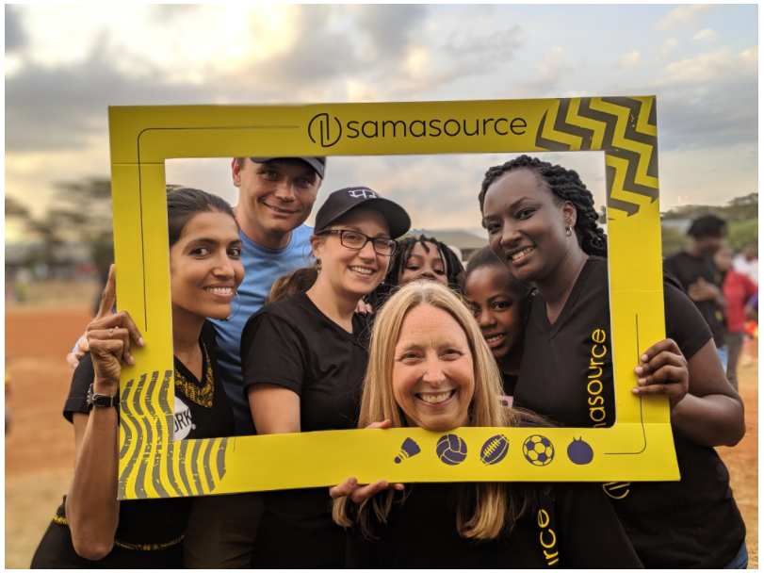
Technical Exercise
PRESENTED BY
Mehul Kumar Das

Slide 2
Introduction
At Samasource they provide training data for computer vision models. Whether they are dealing with image annotation applications, metrics to benchmark how well our services are performed, or tools to help integrate customer data pipelines, reporting and working with images is part of their DNA.

Slide 3
Problem statements
Q1.Write a program in Python that takes in a json(sample-json.json), outputs and generates the following:
Number of unique shape types:
Frequency of each shape and all labels associated with the shapes (for example: 'rectangle' - 'car': 74)
Q2. "Question_2_Images". Given the python script and 1 sample corrupt image (indexed_5d5da9038aa716043cb777f4_0e2ee618-dab5-48c1-b13f-13ca3f8326e6.png), can you please diagnose what the error(s) are and fix the errors?
Create two different images (png or jpeg the shapes i) colors are based on shape types ii) colors are based on annotation label. Check the 3 sets of samples in Question_1_Example_Images for reference. The dimensions of the original image were: 3840 × 2160

Slide 4
Data Collection
Data sets used:
Sample-Json.Json. Dataset is used which contains images, its tags, shapes and labels.
Please open the ipynb file in Jupyter notebook or Google Colab.

Slide 5
Exercise 1 (Architecture & Design)
Here I loaded the JSON file and as per the questions I divided the code into two parts:
First : the count of the image shape types:
After loading the dataset, I assigned the variables to an empty list.
Used For Loop to create an iteration or counter for the images and appended the values of those variables to the empty list.
After that, created a function to tally the unique shapes by assigning the unique shapes in the list to a “set” “s” and then used “length” function to calculate the length of that set ‘s’ which will then give us the count of the unique shapes.

Slide 6
Contd.
Second : i.Frequency of each shape and all labels associated with the shapes (for example: 'rectangle' - 'car': 74)
ii. Create two different images (png or jpeg the shapes i) colors are based on shape types ii) colors are based on annotation label. Check the 3 sets of samples in Question_1_Example_Images for reference. The dimensions of the original image were: 3840 × 2160
For the above two problems:
After loading and reading the data I created a function that combines the shapes and its label of the variable ‘Tagged_Images’ to a zip so as to iterate or counter the count to the shape of the images so that it can be tallied.
Created a dictionary for the key-value pair( shape and value) to create a separate Jpeg or png to visualize it and then appended the value of the dictionary to the list to get the count of the shapes.

Slide 7
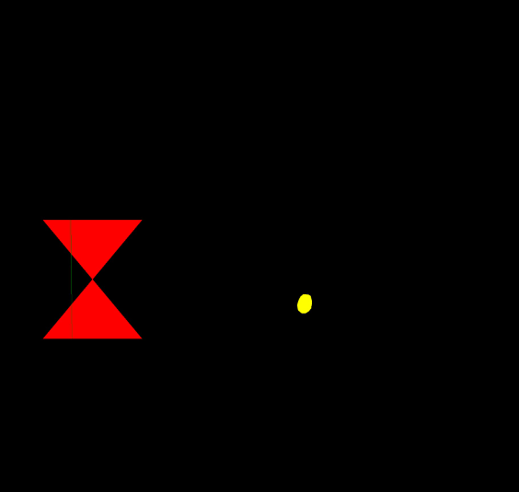
Contd.
c. Created a folder ‘Question 1 Images’ in my local drive to save the jpeg docs that got created. I used a function to assign the dimension mentioned in the question and then used a for loop for iteration on the three shapes i.e. rectangle, line and polygon to be drawn as per the field(car,van etc).
Example of an image that got created in the folder I created.

Slide 8
Exercise 2 (Code review and Bug fix)
Tried to create a list of the rejected images then put the file in two directories, one where i can iterate the images within a folder and second to create a string to save the color details in a csv file so that it is more readable although did not get the desired results.

Slide 9
Thank you

